Slide 1

The Temple Foundations

Slide 2

Our mission
We the Temple foundations will promote the best deals of sellers and provide more options to buyers whereby by facilitating the businesses of both the buyer and seller.

Slide 3
The Temple Foundations
The Temple foundations is an ecommerce company which aims in connecting the “Haves” and “Have-nots”
The first major initiative of ‘The Temple Foundations’ is the “templebricks.com”.

Slide 4
Templebricks.com
Templebricks.com will be the first of its kind in connecting all the dealers(sellers) and builders(buyers) of the civil industry which is a macro industry on a wholesale ground.
Its service will extend to all the building materials that it is required for construction.
Templebricks will promote the best deal to its buyer.

Slide 5
Business Model
Ecommerce and Tender Management.
Target Industry : Civil Industry
Buyers : Builders
Sellers : Dealers
Note: Details are provided in an abstract manner

Slide 6
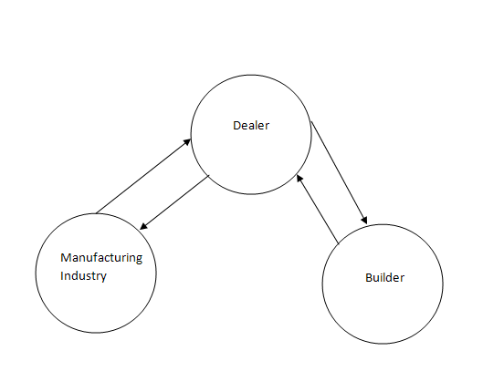
Existing Business Process
Process:
Manufacturing industry produces product.
Dealers enable the manufacturing industry to sell their product.
Builder or buyer buys the product from the dealer.
Note:
Multi-level dealers are present in current system and they have been grouped as an single entity dealer

Slide 7
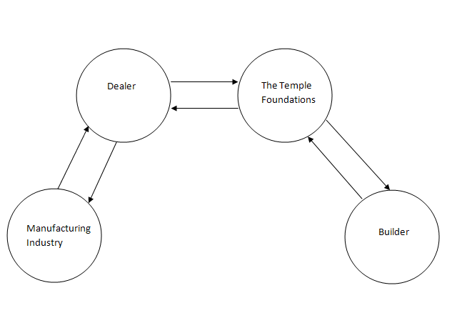
Proposed model
Process:
Manufacturing industry produces product.
Dealers enable the manufacturing industry to sell their product.
Temple foundation enable dealers sell their product and at the same allows the buyer to get the best deal among multiple dealers.
Builder or buyer buys the product from the Temple Founadtions.
Note:
Multi-level dealers are present in current system and they have been grouped as an single entity dealer.

Slide 8
SWOT Analysis
Strength
Simple, new to existence.
Best deals from dealers will never go unnoticed.
More options and varieties for buyers.
One click payment.
Can be Easily expanded to other industries.
Threat
Poor digitalization.
Competitors of tomorrow.
Weakness
Online businesses have still not fancied the “typical” Indian crowd as it is expected.
Opportunity
Huge market potential. “India needs $1 trillion infrastructure spending over 5 yrs : PM”
Will be the future of all macro industry and whole sale businesses as eBay and Amazon is to retail world and micro businesses.

Slide 9
Process
Storing the dealers (sellers) information and various prices of his products.
Providing the deals which are of low cost to the buyers without revealing information about the dealer.
Handling transaction without handling shipment.

Slide 10
Process Contd
Buyer will initiate the process. He will transfer the cash to the temple foundations account.
Seller will be asked to ship the product to the buyer location.
Once buyer confirms the delivery. Cash will be transferred to the dealers account.
4% will be taken as commission from seller. Buyer will not be charged.

Slide 11
Important Dates
Market Research : 20-11-2010 to 31-11-2010
Opening company : TBD
Hosting of templebricks : 14-01-2011

Slide 12
Organization Structure
Chief Executive Officer – Alagiri Samy.S
Chief Marketing Officer – Viswa Prakash Das
Chief Technical Officer – Michael Jaison
Chief Financial Officer – Yet to hired
Chief Legal Officer - Yet to hired

Slide 13
Roles
Michael Jaison – Chief Technical Officer
  Website development with good better user experience.
  Server maintenance.
  Team building
Viswa Prakash Das
  Market research.
  New strategies of Marketing.
  Field work Coimbatore and Trichy.
  Team building.

Slide 14
Roles contd
Alagiri Samy (Chief Executive officer)
  Market research.
  Website designing.
  Field work in Chennai, Madurai and Tirunelveli.
  Strategies.
  Collecting contacts.
  Financial estimation.
  Team building.

Slide 15
“We can because we think we can”
Note : This is not for circulation

